Slide 1
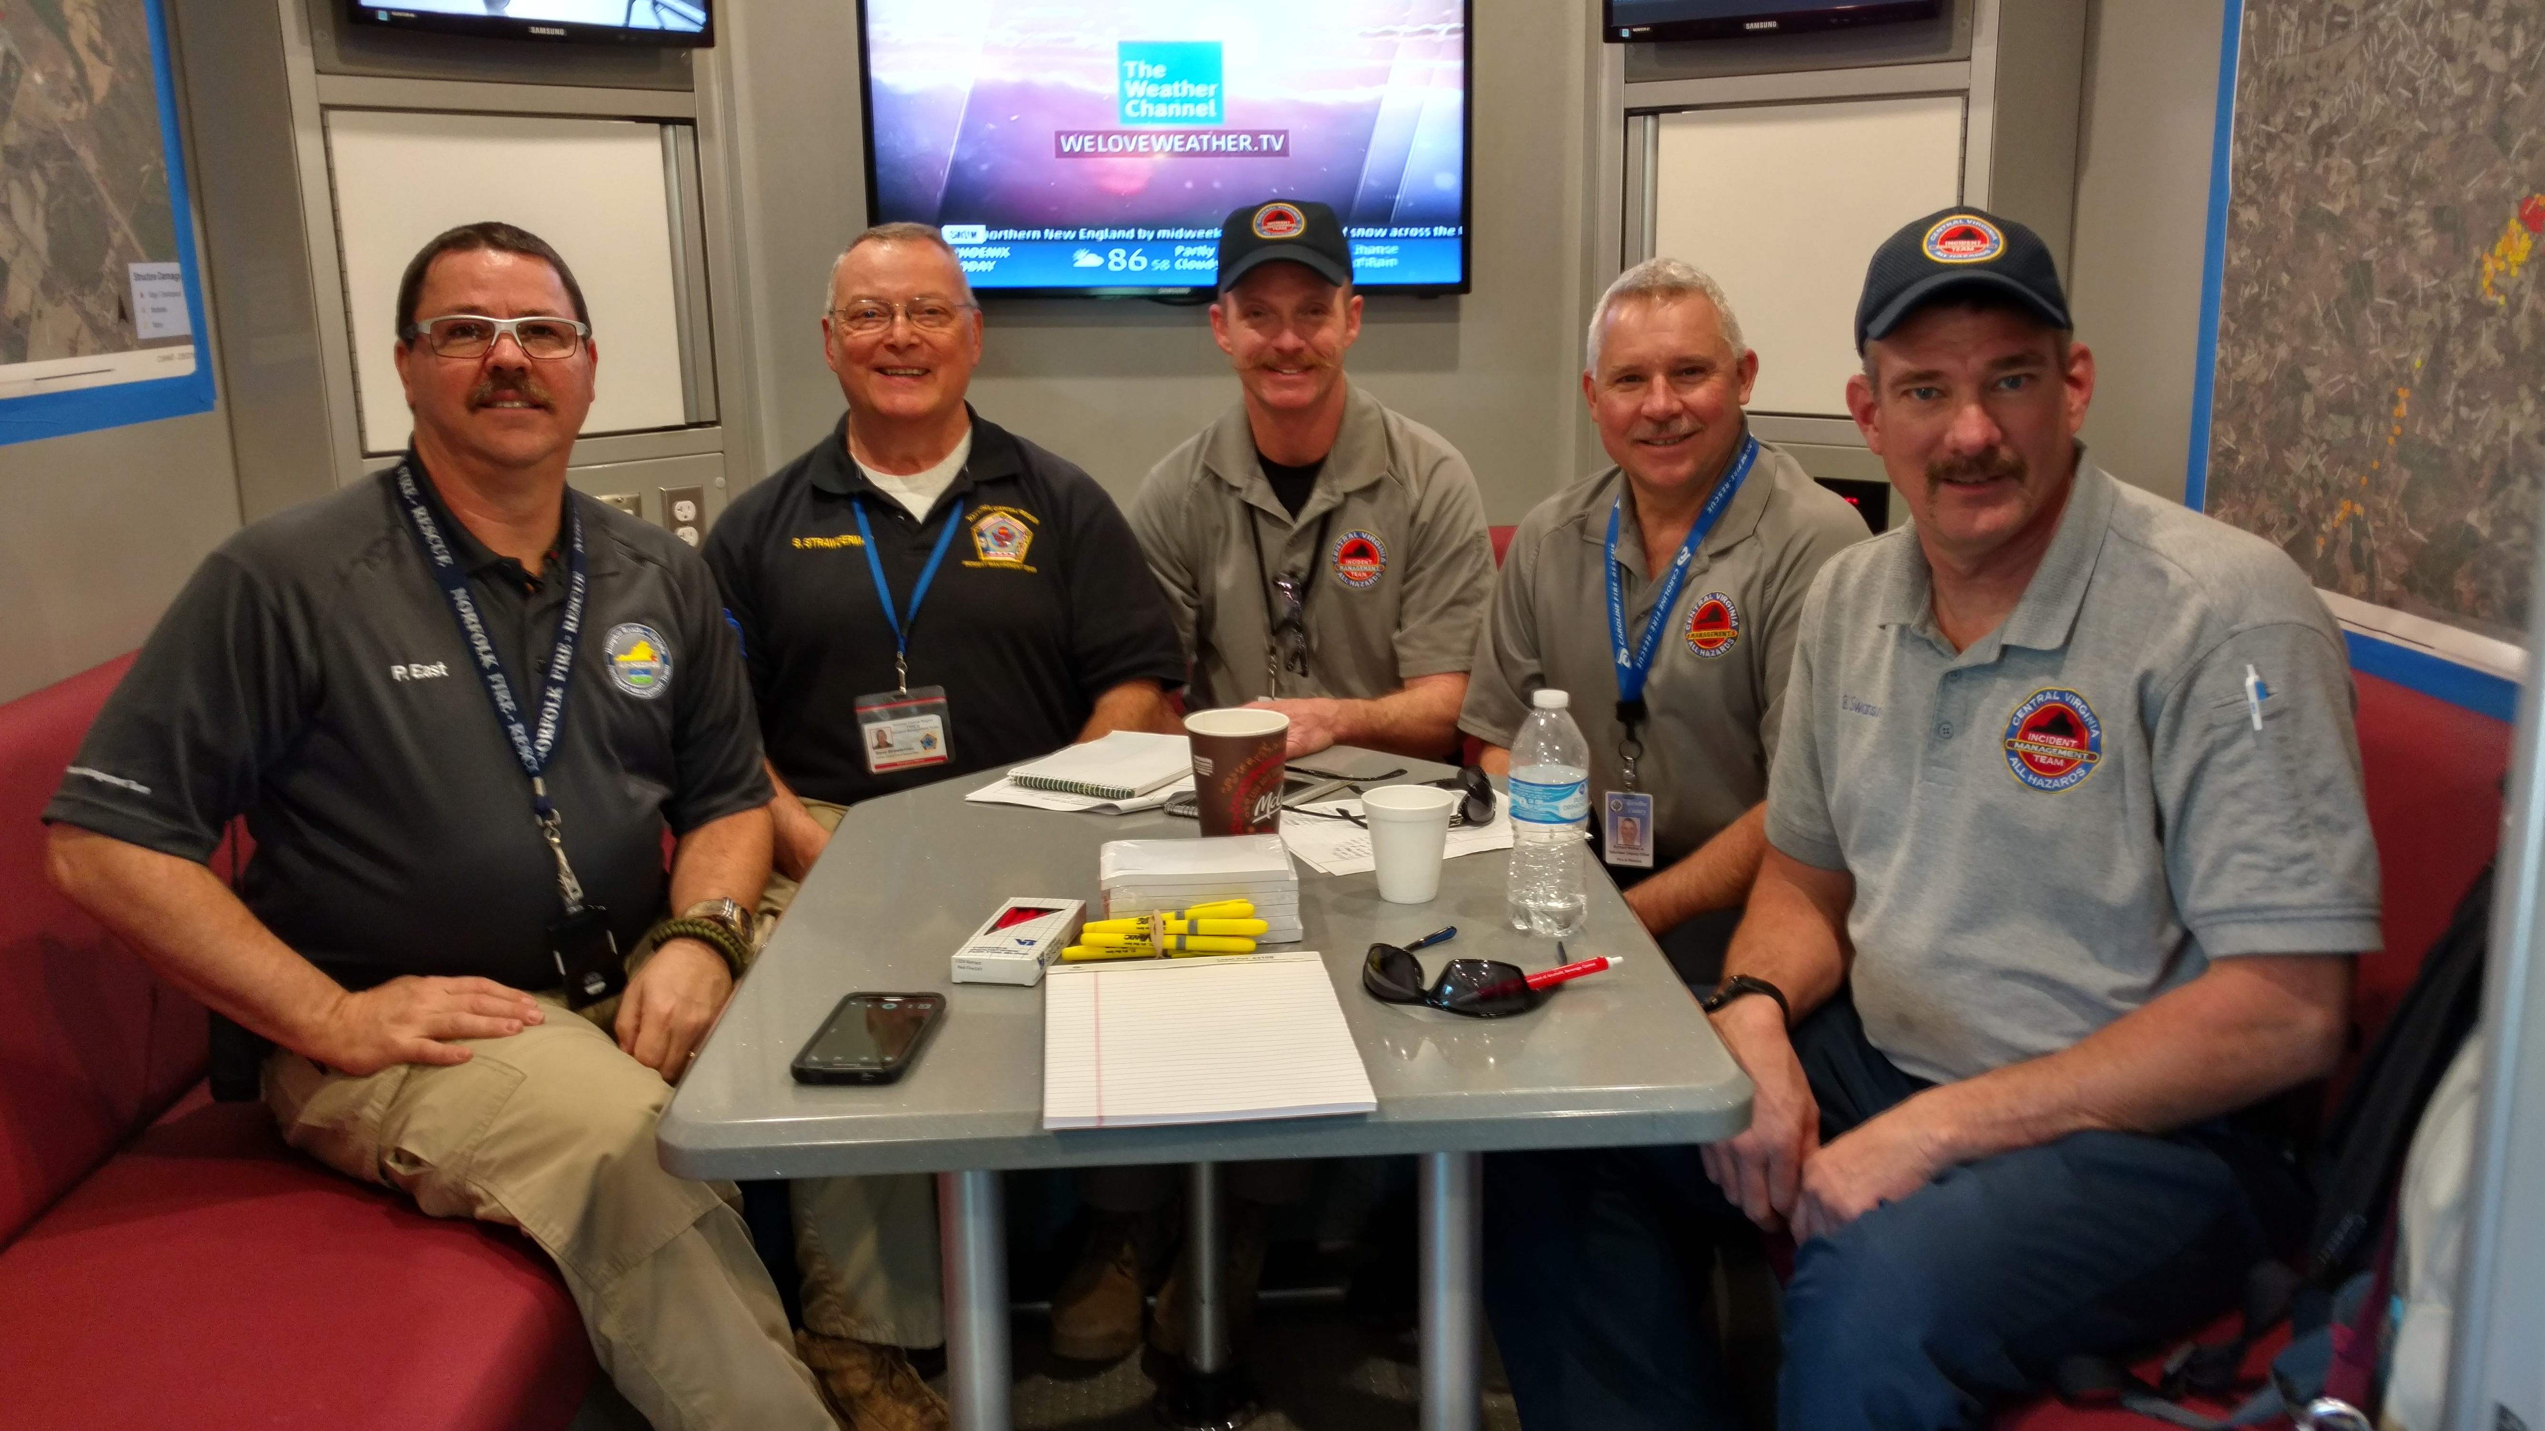
All-Hazard Incident Management Teams
Central Virginia – IMT
Hampton Roads – IMT
National Capital Region – IMT
Southwest Virginia - IMT

Slide 2
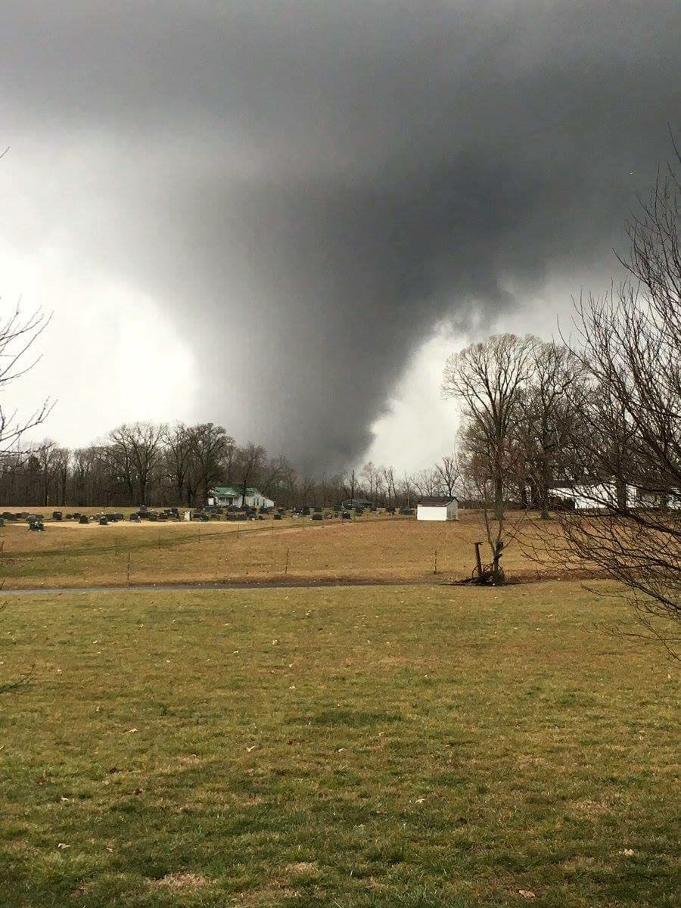
“All-Hazard” Low frequency - High Criticality
Natural Disasters – flood, tornado, hurricane, blizzard
Manmade Disasters – HazMat, structural collapse
Terrorist Attacks – NYC and Boston
Civil Unrest – Baltimore and Charlotte
Public Health Emergencies – Pandemic Flu
Transportation – aircraft, train, ship, Metro

Slide 3
“Rules of Engagement”
Deployed through VDEM and the VA-EOC
The IMT works for and with the requesting jurisdiction and/or agency
Augments and supports the local jurisdiction
Financial arrangements for the IMTs
Scalable Depending on Complexity
15-person short-team
30-person long team
Equipment cache
Specific Section, e.g. Planning or Logistics
EOC support

Slide 4
“Incident Commander” – Team Leader
Coordinates with VDEM and the requesting jurisdiction/agency
Obtains a briefing from the AA/AE to determine rules of engagement, scope of work, direction, priorities, desired outcomes, sensitive issues, etc.
Obtains a briefing from the initial IC in order to determine the specific scope and status of the incident
Discuss the need for a “Letter of Expectation”
Help to determine who should participate in Unified Command
Help to develop incident priorities, objectives, limitations and constraints, decisions, directives, etc. that outline how the incident will be managed.

Slide 5
“Incident Commander” – Team Leader
Help to evaluate “incident complexity” and determine resource and IMT needs
Help to evaluate and identify “sensitive factors” that impact the incident, e.g. media, political, environmental, fiscal, cultural, etc.
Help to integrate the IMT into the current local effort
Leverage the Command Staff (Safety Officer, PIO, and Liaison Officer as “force multipliers”
Help to build relationships and enhance communications with the public, stakeholders, local, state, and Federal agencies
Manage the team while the team manages the incident

Slide 6
Command staff
Support IC and Incident
ICS-215A – Safety Analysis
Public Information Officer - PIO
Safety Officer – SOFR
Liaison Officer

Slide 7
Command staff
Public Information Officer
Safety Officer
Advises IC on information dissemination and media relations
Obtains and provides information from/to the Planning Section
Obtains and provides information from/to the Community and Media
Advises IC of Incident Safety Issues
Works with Operations Section to ensure Safety of field personnel
Ensures the Safety of all Incident Personnel
ICS Forms 206, 208, and 215A
Liaison Officer
Assists IC by serving as “Point of Contact” for representatives from other response organizations/agencies
Provides briefings to and answer questions from supporting organizations/agencies

Slide 8
The Planning Section
2016 VEMA Fall Forum
Progress from current reactive operations to a planned and proactive response.

Slide 9
Planning Section – Primary duties
Planning process provides organization and structure
Reactive to proactive
Plan for the next operational period
Meetings and Briefings
Incident Action Plan (IAP)
Units within the Planning Section
Resources Unit
Situation Unit
Technical Specialists
Documentation Unit
Demobilization Unit

Slide 10
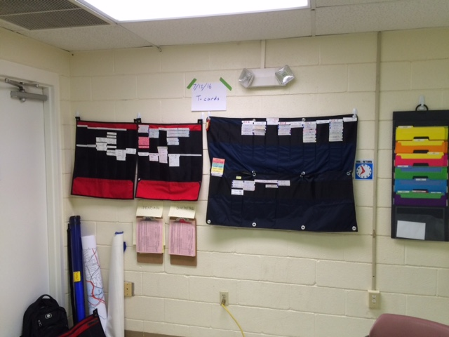
Resources Unit
Check-in of all resources
Account for all resources
Maintain status of all resources
Develops strike teams and task forces
Assigns units to the IAP

Slide 11
Situation Unit
Maintain current situation and status
Situational Awareness and Common Operating Picture
Display boards
GIS and Maps
Projections
ICS-209 Incident Status Summary
Contingency Planning

Slide 12
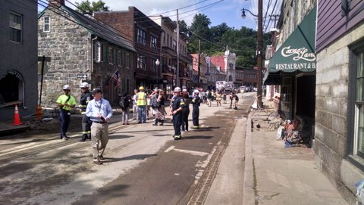
Technical Specialists
Meteorologist
HazMat
Structural Engineer
Public Health Scientist
Hydrologist

Slide 13
Demobilization Unit:
Planned demob of resources
Safety
Accountability
Payroll
Property and equipment
Travel
Documentation Unit:
Maintain all incident documents
IAPs
ICS-214’s
Contracts
Supply orders
Injury reports
Time reports (personnel and equipment)

Slide 14
The OPERATIONS Section
2016 VEMA Fall Forum
Develop strategies and tactics to achieve the IC/UCs priorities and incident objectives

Slide 15
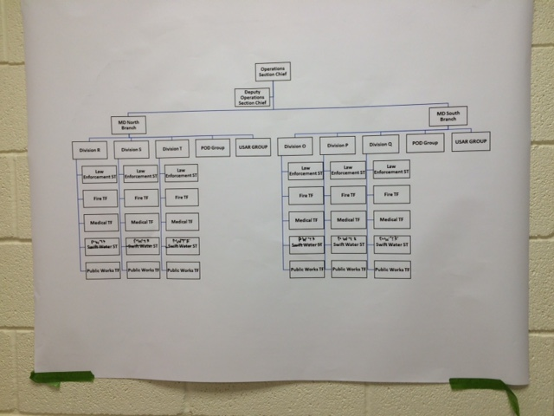
Operations Section
Develop the “OPS” organization
Safety
Span of Control
Resources
Develop Contingency Plans
Brief operational personnel prior to assignment
Implement and supervise the tactical portion of the IAP
Primary Duties of the OPERATIONS Section

Slide 16
Tactics Meeting
Develop tactical plan for the next operational period – IAP – ICS-204s
Organization
Work assignment
Resources needed
Safety hazards and mitigations
Specialized equipment
Operations Organization
Branches (OPBD)
Divisions and Groups (DIVS)
Strike Teams and Task Forces
Crews and Teams
Single Resources
Aircraft (AIROPS)
Staging Area Manager (SAM)
Primary Duties of the OPERATIONS Section

Slide 17
The LOGISTICS Section
2016 VEMA Fall Forum
Providing essential resources, services, and support that enables the responders and IMT to accomplish the mission. Logistics is a critical function to successfully mitigate the emergency

Slide 18
Communications Unit
Interoperable Communications
Communications Plan (ICS-205)
Portable radios
Satellite Services (voice and data)
Repeaters
Towers

Slide 19
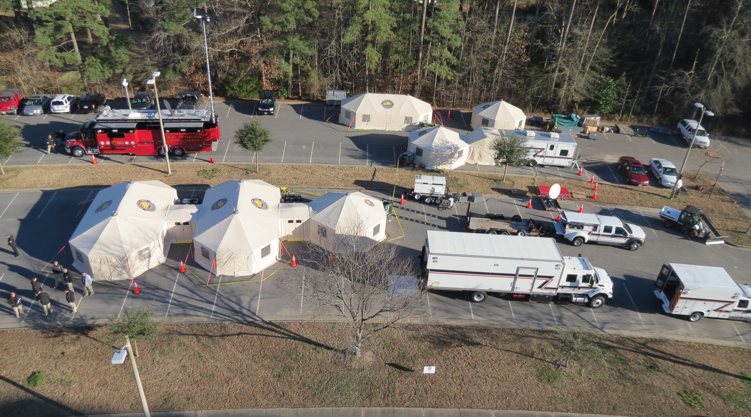
SUPPLY UNIT (SPUL)
Ordering resources and supplies
Distribution
Operates Base
Repairs
Inventory
Property accountability

Slide 20
More Logistical Support
Medical Unit
Ground Support Unit
Provides medical care to responders
Develops Medical Plan (ICS-206)
Field paramedics and EMTs
Utilizes data to prevent injuries and illness
Works closely with SOFR and COMP
Transport responders
Inspect vehicles
Traffic Plan
Fuel
Repairs
Fleet management

Slide 21
“New general focus on strategy and tactics. Experienced generals focus on logistics”
Facilities Unit
Food Unit
Incident Command Post (ICP)
Base
Camps
Staging Areas
Utilities
Cleaning/maintenance
Construction
Food Safety (sanitation, storage, temperature, exposure)
Nutrition
Timely
Field Kitchens
“Bag lunches”
Catering contracts

Slide 22
Logistical Support - Branches
Service Branch Director
Support Branch Director
Communications Unit Leader
Medical Unit Leader
Food Unit Leader
Ground Support Unit Leader
Supply Unit Leader
Facilities Unit Leader
Ordering

Slide 23
Finance Section
Responsible for all Financial, Administrative, and Cost Analysis aspects of the incident. Essential for legal procurement, financial documentation, and cost recovery/reimbursement for the impacted community.

Slide 24
Cost Unit
Procurement Unit
Collecting cost data
Performing cost analysis
Providing cost estimates
Purchasing
Contracts
Land Use Agreements
Coordinate with local EOC
Compensation and Claims
Injuries and fatalities
Damage claims against the incident
Investigation

Slide 25
Time Unit
Personnel costs
Equipment costs
Aircraft costs

Slide 26
Local Incident/Event
Regional Incident/Event
Contact local IMT directly
Request IMT via Local EM
Request IMT via VDEM Regional Coordinator
Request IMT via VEOC
Request IMT via Local EM
Request IMT via VDEM Regional Coordinator
Request IMT via VEOC
State Incident/Event
Request IMT via VDEM Regional Coordinator
Request IMT via VEOC
Requesting an imt and resources

Slide 27
Hampton Roads IMT
Central Virginia IMT
Mike Gurley – Program Manager
(757) 319-0618
mgurley@cityofchesapeake.net
Chesapeake Emergency 9-1-1 Center
Bryan Swanson – Program Manager
(804) 840-2815
swansonb@chesterfield.gov
National Capital Region IMT
South West IMT
Daryl Louder – Program Manager
(571) 221-5667
Daryl.louder@fairfaxcounty.gov
In development
COV IMT Contact Information

Slide 28
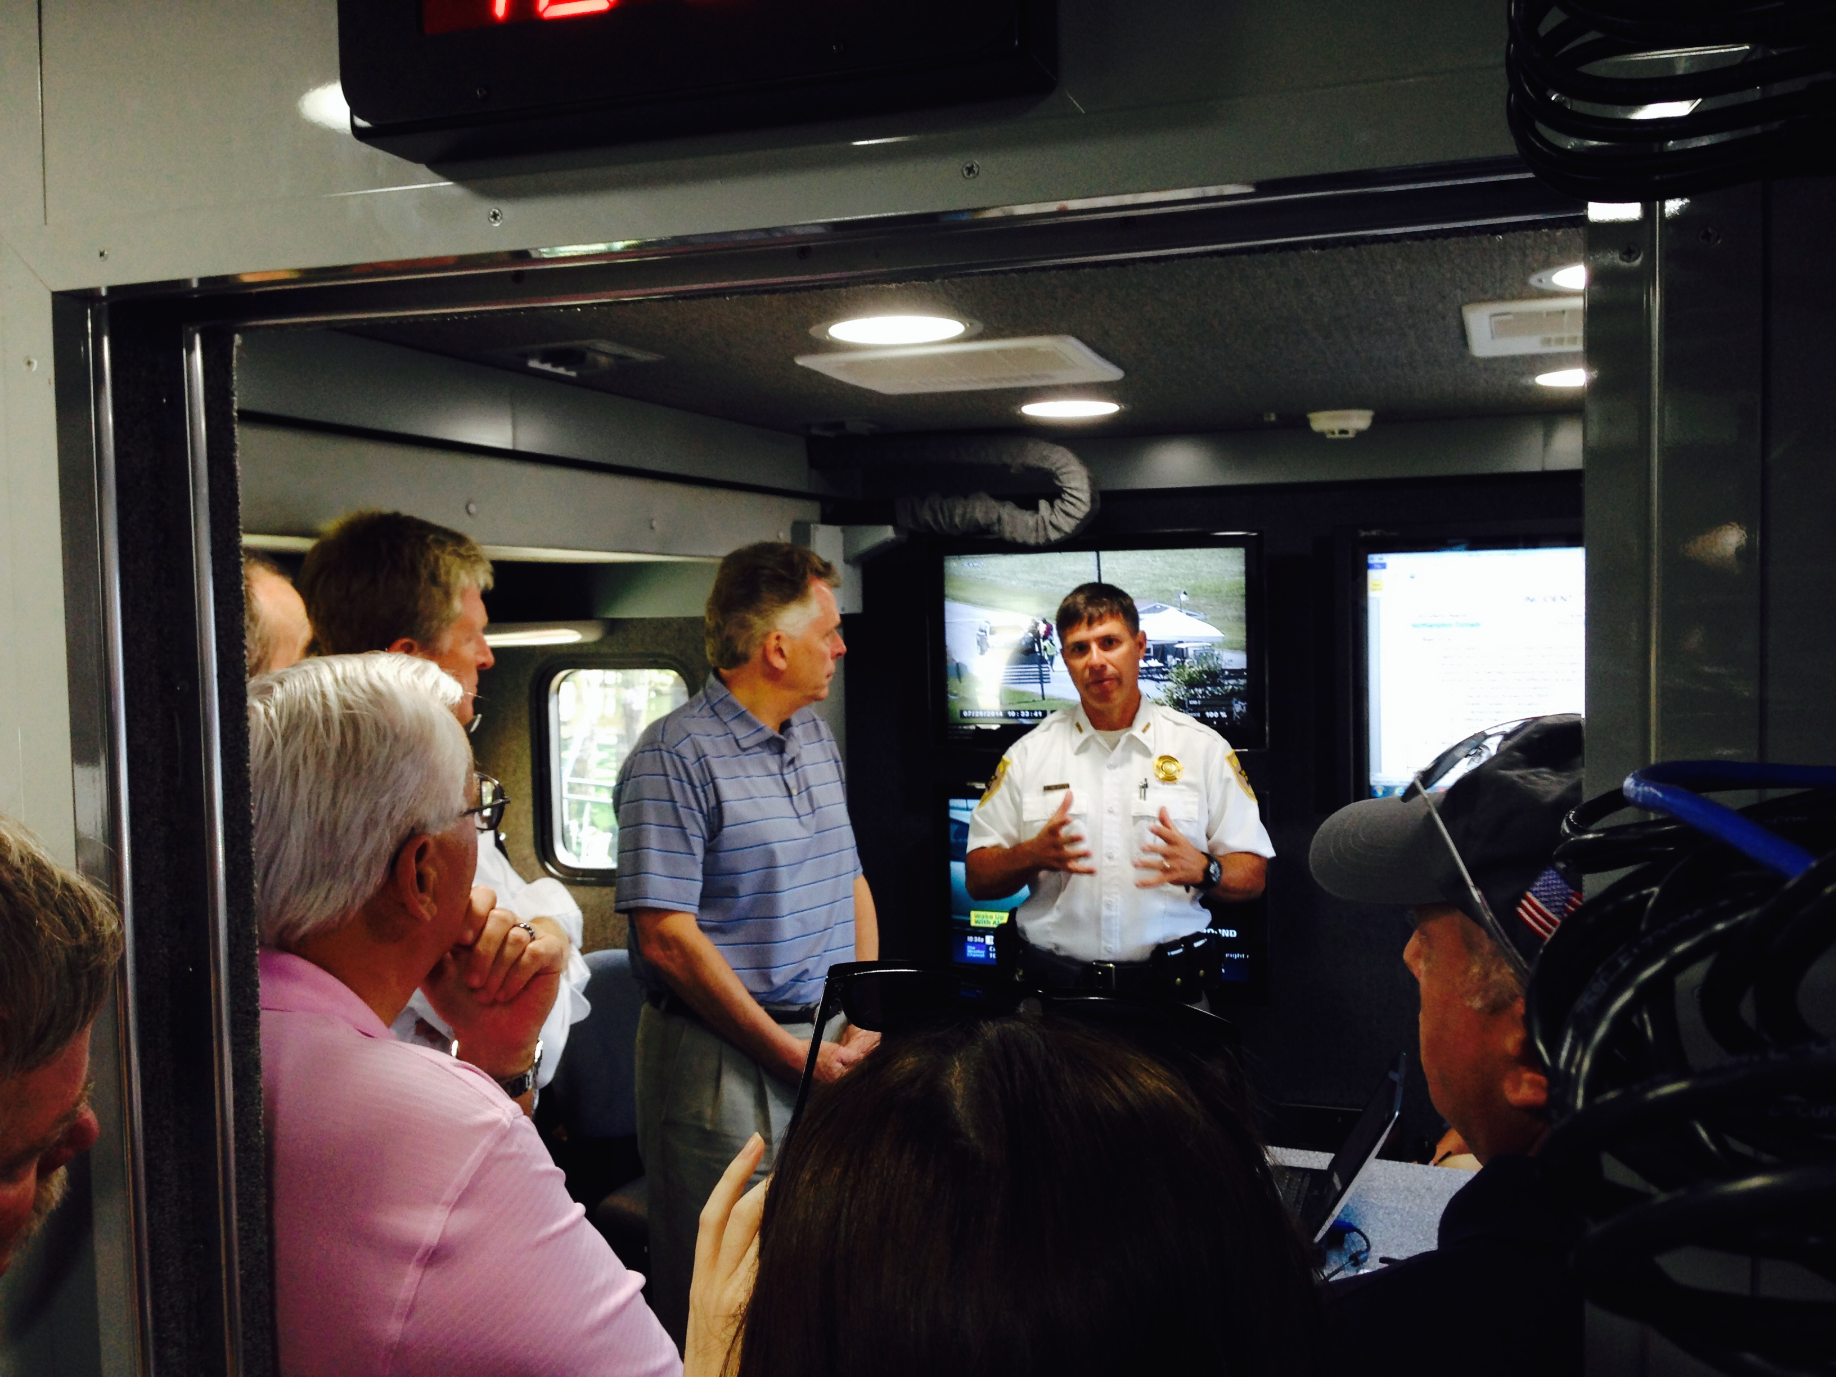
QUESTIONS

